Slide 1
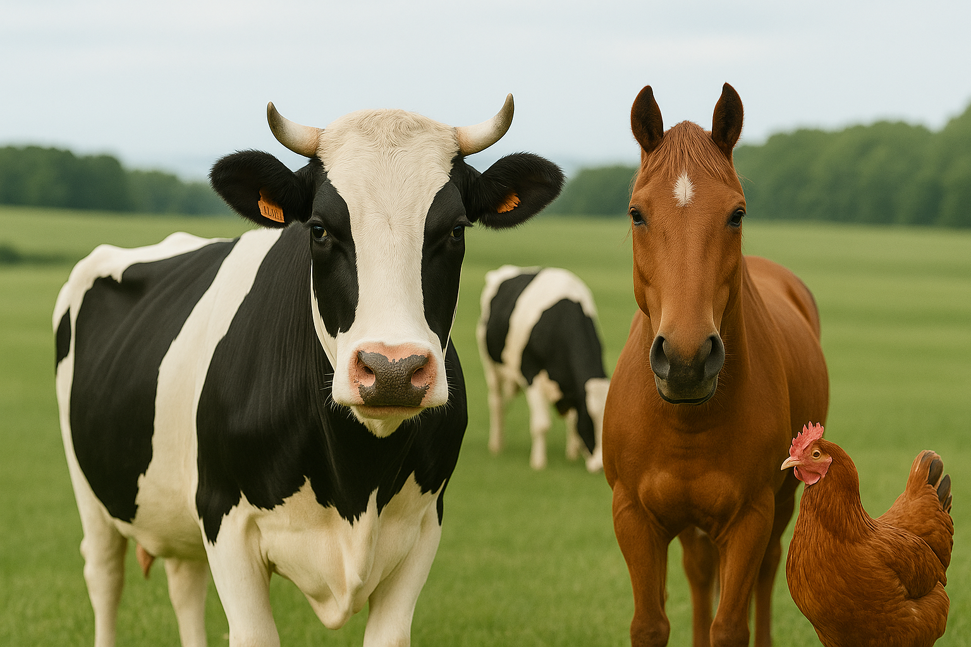

PredictVet
AI-Supported Animal Disease Prediction System
Aysegul Akyuz
40698
Supervisor: Ruslana Prus

Slide 2
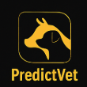

Project Overview
PredictVet is a machine learning-based web application designed to predict potential animal diseases using inputs such as animal type, age, temperature, and symptoms.
The system aims to assist veterinarians and livestock managers in early diagnosis, reduce unnecessary testing, and improve animal health outcomes through fast and intelligent support.
2

Slide 3
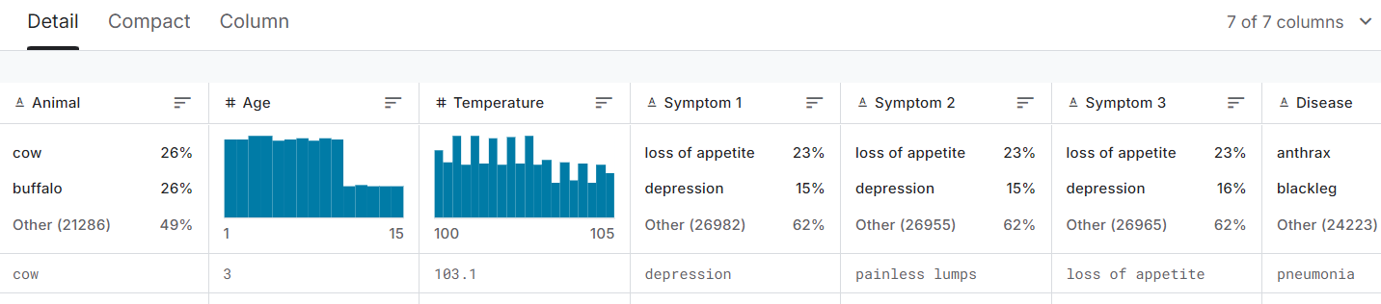
Dataset and Preprocessing
📥 Source: Kaggle – 6 animals, 15 diseases
➕ Enrichment: +10 diseases, new symptoms added
📚 References: CDC, WHO, FAO, Merck Vet Manual
🧪 Validation: Species-based age & temperature ranges
⚙️ Preprocessing: Label encoding, symptom binarization

Slide 4
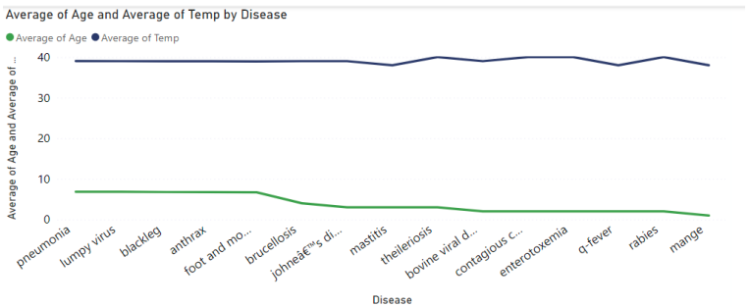
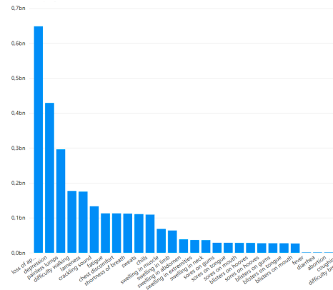
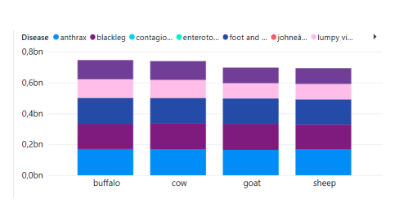
Power BI Visualizations
Avg. age & temp by disease
Most frequent symptoms in dataset
Disease distribution by animal

Slide 5
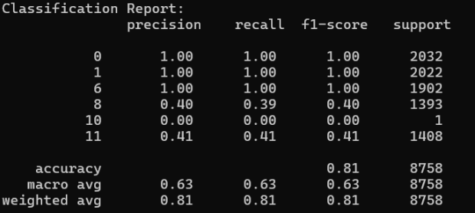
Model Architecture & Evaluation Metrics
🔍 Model : Random Forest Classifier • Parameters: n_estimators = 100, random_state = 42
📊 Train/Test Split: 80% Training – 20% Testing
💡 Why Random Forest? • Excellent with structured/tabular data • Handles multiclass classification well • Lower risk of overfitting
⚠️ Observations: • Strong performance on common diseases • Weak results on rare diseases (due to data imbalance) • Future improvements: class weighting or oversampling
✅ Evaluation Metrics: • Accuracy: 81% • Weighted Avg F1-score: 0.81 • Macro Avg F1-score: 0.63

Slide 6
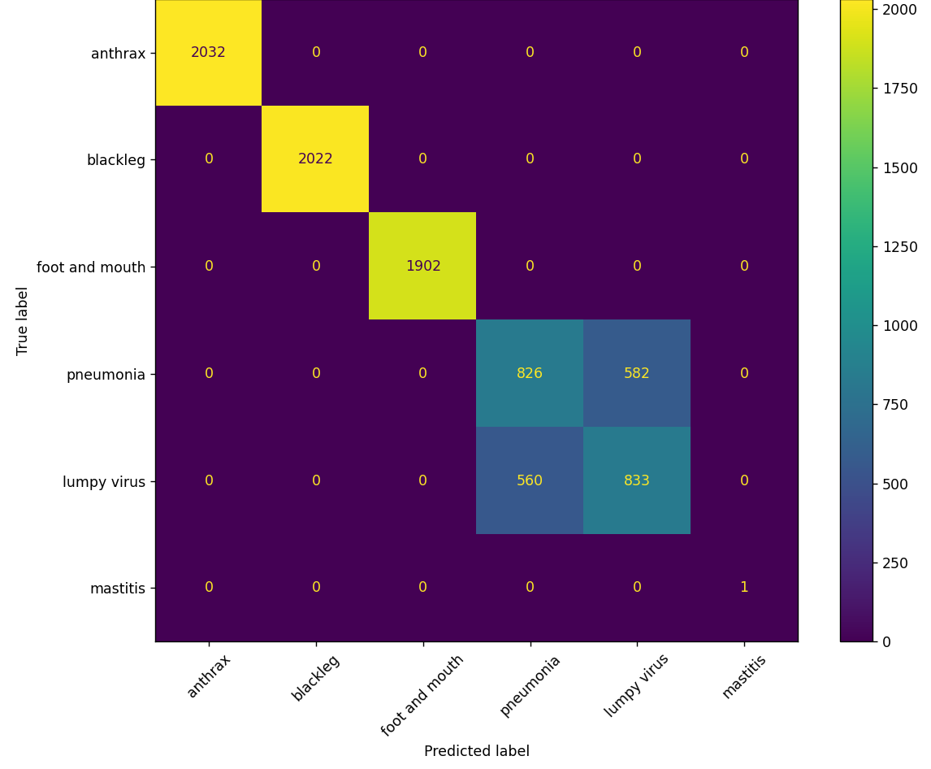
Confusion Matrix
✅ High Accuracy Diseases: • Anthrax – 100% accuracy • Blackleg – 100% accuracy • Foot and Mouth – 100% accuracy
⚠️ Misclassifications: • Pneumonia → Lumpy Virus: 582 cases • Lumpy Virus → Pneumonia: 560 cases → Similar symptoms caused confusion
❗ Rare Disease Issue: • Mastitis & Class 10: very low sample size → Result: 0% accuracy, low F1-score

Slide 7
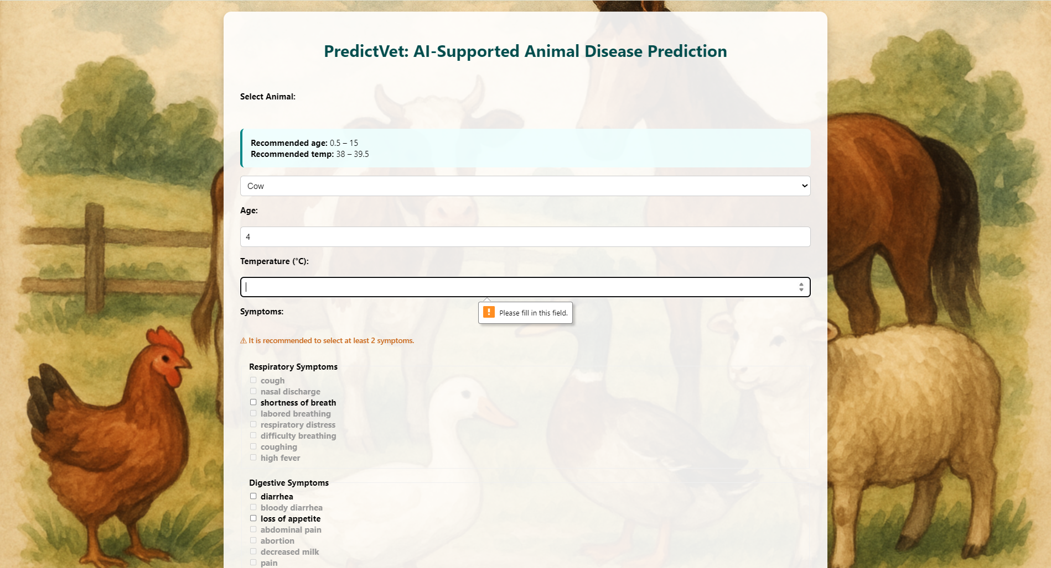
PredictVet Web App 💻
🛠️ Technologies Used: Backend: Flask (Python) Frontend: HTML, CSS, JavaScript Model Integration: Joblib (for loading trained model) Hosting: Render.com (free tier, GitHub-based deployment)
➕ Key Features of the Web App:
• Animal-specific validation: → Each animal has unique reference ranges for age & temperature
• Grouped symptom input: → Symptoms are organized into categories (e.g., respiratory, digestive)
• Real-time prediction: → The model returns disease output instantly after submission
• Input validation and error feedback: → Warnings for missing or invalid entries (e.g., empty symptom list)
• User-friendly design: → Clean layout, simple interface, responsive flow
🌐 Deployment: Public link: https://predictvet.onrender.com

Slide 8
Limitations & Future Work
⚠️ Current Limitations
• Imbalanced dataset → Rare diseases had very few samples → low performance
• Symptom similarity → Pneumonia and lumpy virus often confused
• No confidence score → Prediction results lack certainty level
• Limited user interface → English-only, not mobile-optimized
• Symptom duration not supported → Input is binary (checked or not)
🌟 Planned Future Improvements
• Add more animal types, diseases & symptom details • Apply balancing techniques (e.g., SMOTE, class weighting) • Include prediction confidence level with explanation • Build multilingual UI (Polish, Turkish, etc.) • Design mobile app for offline rural use • Allow severity/duration input for symptoms

Slide 9

References & Links
• Kaggle – Livestock Disease Dataset
• CDC – Brucellosis, Q-Fever
• WHO – Rabies
• FAO – CCPP, Theileriosis
• Merck Vet Manual – BVD, Johne’s Disease
• DairyNZ – Mastitis
• Render.com – Deployment
• Power BI – Visualizations
🔗 Project Links:
• Live App: 👉 https://predictvet.onrender.com
• GitHub Repository: 👉 https://github.com/aysegulakyuuz/PredictVet

Slide 10
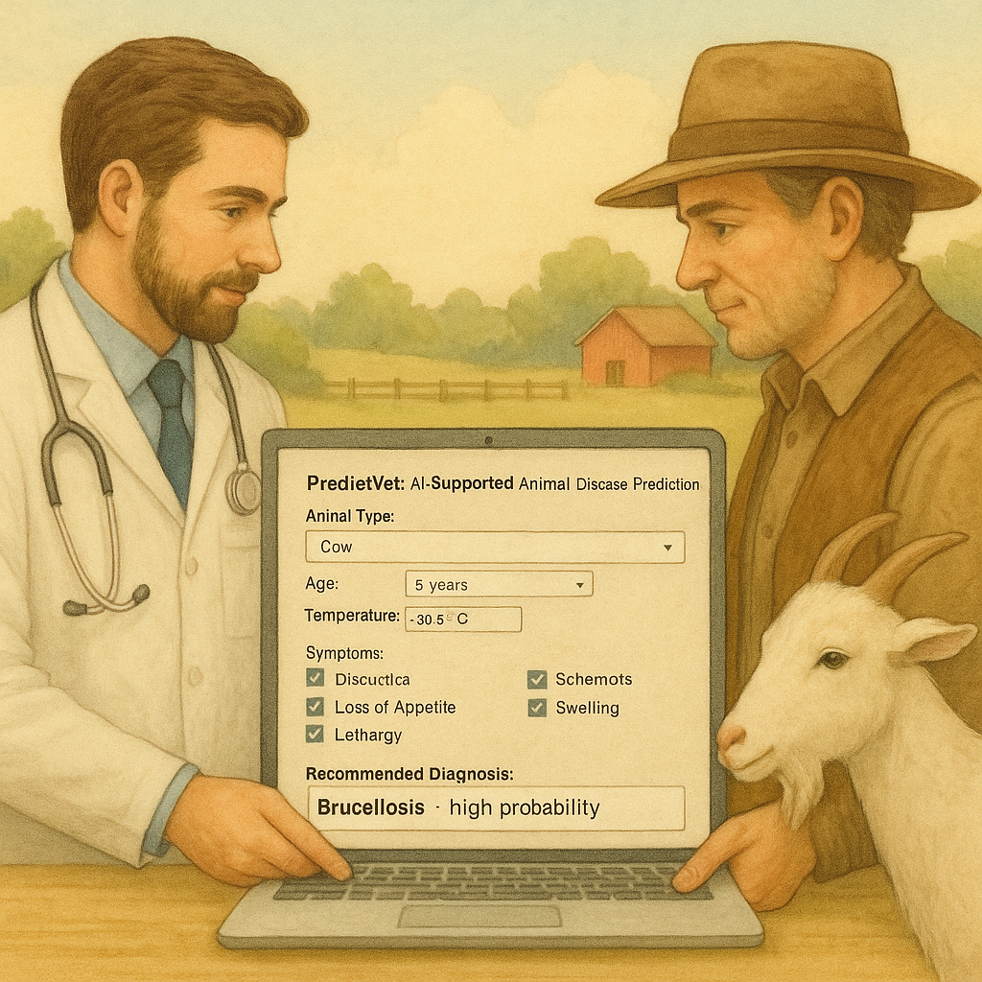
🙏 Acknowledgements
To my supervisor Ruslana Prus – for her academic guidance and support To the VIZJA UNIVERSITY – for fostering this opportunity and providing a valuable academic environment
Prepared by Ayşegül Akyuz
Student No: 40698

